Slide 1
Credit Card Fraud detection Capstone Project – upGrad Campus
By,
Gopi Bollineni
UGC-DA-2651
Data Analytics

Slide 2
Table of Contents
Detecting and preventing fraudulent transactions:
Objective
Background
Key findings
Recommendations
Appendix:
Data Sources
Data methodology
Data model assumptions

Slide 3
Objective
Improve our shared understanding of the metrics and variables that lead to reduction of fraudulent transactions.
Improve our shared understanding about fraudulent transactions.
Provide early recommendations to the bank so as to take actions towards reducing fraudulent transactions.

Slide 4
Background
The fraudulent transactions in the whole dataset are only about 0.5%.
Several data points with various features have been collected which indicates that the characteristics of the fraudulent transactions can be found.
However, the features or data characteristics that need to be focused on by the bank need to be determined through thorough analysis of the vast amount of data and recommended to the bank.

Slide 5

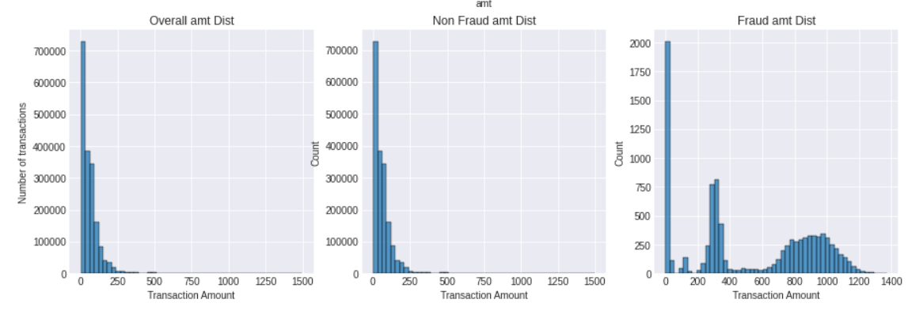
Low volumes of the fraudulent transactions is making it difficult to distinguish between ‘genuine’ and ‘fraud’ transactions.
The total number of ‘Fraud’ transaction is only about 0.5% compared to the 99.5% non-fraud transactions.
The distribution of the ‘amt’ variable is highly skewed. The overall amount and the non-fraud amount distributions are skewed towards the left indicating high variance and low mean.
However, the mean of the Fraudulent transactions is far higher than that of the overall or non-fraud transactions.

Slide 6
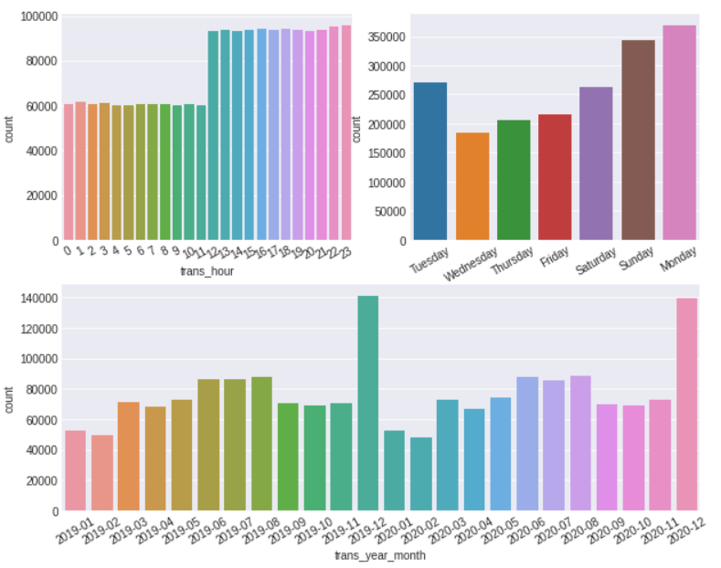
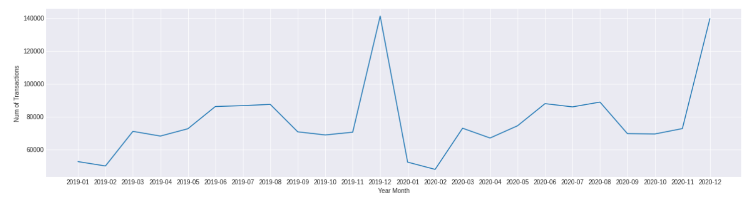
Top causes for high skewness in amount variable
Most transactions are happening below the $500 mark.
However, the fraudulent transactions often draw much more amount.
Fraudulent transaction seldom occur and hence are difficult to be detected.
Most fraudulent transaction occur on days or in hours when the transaction volumes are high hence making them even more difficult to be detected.
The holiday seasons have very high transaction volumes resulting in more number of fraudulent transactions happening during these times.

Slide 7
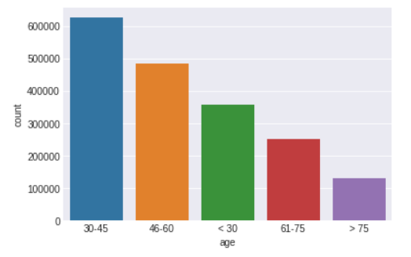
Several sections of the public specifically have high rate of fraudulent transactions
Women contribute to majority of the transaction volumes than men. Hence, the shopping categories preferred by women are most exploited by fraudsters.
The elder age group of people above 75 years have been subject to the most number of fraudulent transactions than any other age group.

Slide 8
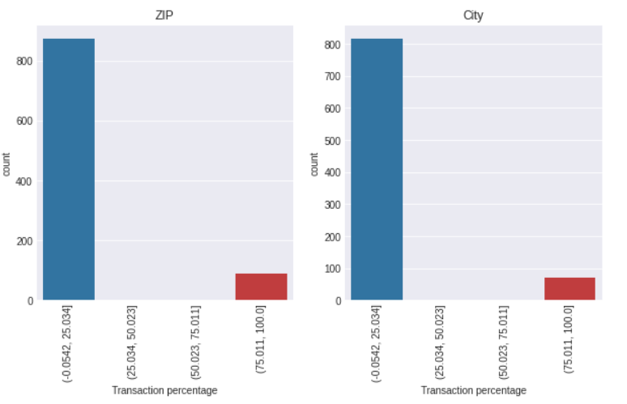
Certain cities/zip codes/ States seem more susceptible to fraud
The state ‘DE’ has a 100% fraud rate.
About 50 zip codes and 70 cities have more than 75% fraudulent transactions.

Slide 9
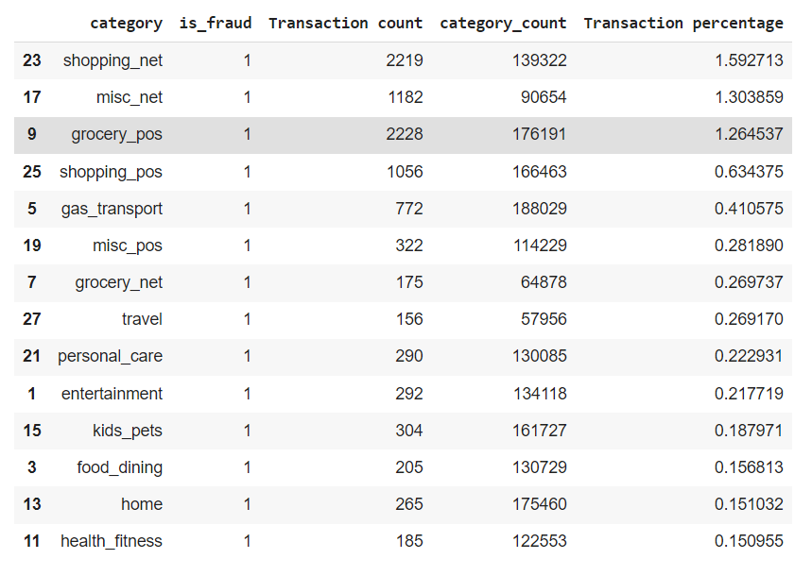
Several transaction categories are more susceptible to fraud
‘Shopping_net’, ‘misc_net’, ‘grocery_pos’ are the top transaction categories with most number of fraudulent transactions.
This might be because in these categories, the mode of payment is either the Point-of-Sale(POS) machine or an online portal, both of which can be tampered with in order to fraud the customers.

Slide 10
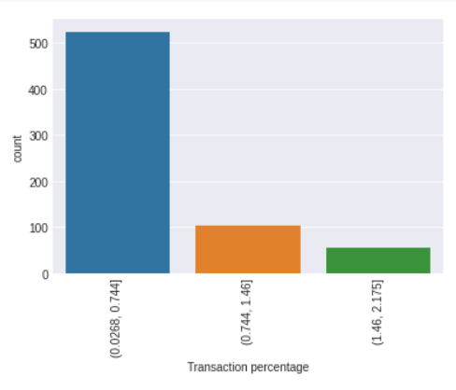
Several merchants have more than usual amount of fraud rate
About 140 merchants have more than 1% transactions associated with them as fraudulent transactions.
Also, the merchants fraud_Brown PLC; fraud_Goyette Inc; fraud_Herman; Treutel and Dickens; fraud_Jast Ltd; fraud_Kerluke-Abshire; fraud_Kozey-Boehm; fraud_Schmeler, Bashirian and Price; fraud_Terry-Huel are top merchants with highest number of fraudulent transactions.

Slide 11
Recommendations
Focus more efforts on identifying fraudulent practices occurring at the ground level.
Focus more on sectors of people who transact more and those categories wherein there is a higher risk of fraud.
Employ additional security measures to confirm transactions involving large sums of money directly with the customers.

Slide 12
APPENDIX – DATA SOURCES
Here is a snapshot of our data dictionary:
Credit card holder demographics such as age, gender, occupation, address.
Characteristics of transactions done by the card holder like timestamp of transaction, amount, etc.
Following data sources were used:
Credit card transaction data from bank
Fraud data

Slide 13
APPENDIX – DATA METHODOLOGY
We conducted a thorough analysis of the credit card fraud dataset. The process included:
Cleaning the data set using fuzzy logic
Creating visualizations to compare various features and determine trends in the data and form inferences.

Slide 14
APPENDIX – DATA ASSUMPTIONS
There were certain gaps due to data unavailability. Therefore, the following assumptions have been made:
The features ‘Zip’, ‘lat’, ‘long’, ‘merch_lat’, ‘merch_long’ have not been thoroughly considered in our analysis, since these features did not seem to provide any additional information.

